Slide 1


ethical dimensions OF AI!
Presented by Rinshad Choorappara
12/12/2023

Slide 2


What is ai?
What are ethics?
what about ethical dimensions of ai?

Slide 3
artificial intelligence
Artificial Intelligence (AI) stands at the forefront of technology, aiming to develop machines with human-like intelligence. This interdisciplinary field intersects computer science, mathematics, and cognitive science to create systems capable of tasks such as learning, problem-solving, and understanding natural language. As AI evolves, it transforms industries, offering the potential for machines to think and adapt in ways that parallel human intelligence.

Slide 4
ethics
Ethics refers to the moral principles and values that guide human behavior, distinguishing between right and wrong. It provides a framework for individuals and societies to make decisions that are fair, just, and considerate of the well-being of others. Ethical principles shape our actions, interactions, and decisions, fostering a sense of responsibility and accountability in various aspects of life.

Slide 5
What if there are no ethics in ai?

Slide 6
what if the iq of machines become the same as humans?

Slide 7
What will be the future of ai?

Slide 8

We will be discussing all dimensions of Artificial Intelligence in this presentation.
AI has automated a lot of tasks. It has made each and every daily tasks more simple and efficient. But we all have missed many concerns on this evolving and booming AI world.
Let’s start!

Slide 9


AI revolution
1
5
Healthcare
Education
2
6
Finance
Marketing
3
7
Transportation
Retail & eCommerce
4
8
Manufacturing
Jobs

Slide 10

AI Revolution:
Artificial intelligence (AI) is revolutionizing various aspects of our lives, from healthcare and finance to transportation and manufacturing. It is transforming industries, enhancing productivity, and improving our lives in countless ways. As AI continues to evolve, we can expect to see even more transformative applications that will shape our future.

Slide 11

The invention of ai pin:
AI Pin by Humane.

Slide 12
AI/ar in healthcare:
Have a look at this video. The concept of Atul Gupta on AR using on Healthcare (AI Virtual Assistant)

Slide 13
Now let’s talk about challenges of ai!

Slide 14
AI Challenges:
Ethical Concerns:
Bias and Fairness: AI systems can inherit biases present in their training data, leading to unfair and discriminatory outcomes, particularly against certain demographics.
Transparency: The lack of transparency in AI algorithms can make it difficult to understand how decisions are made, raising concerns about accountability and ethical use.
Job Displacement and Economic Impact:
Automation: The widespread adoption of AI and automation technologies in various industries may lead to job displacement, potentially causing economic and social disruptions.
Skill Gaps: The rapid evolution of AI requires a workforce with updated skills. There is a challenge in ensuring that education and training programs keep pace with the changing demands of the job market.

Slide 15
AI Challenges:
Privacy and Security:
Data Privacy: AI systems often rely on vast amounts of personal data, raising concerns about individual privacy and the potential misuse of sensitive information.
Cybersecurity: The integration of AI into critical systems increases the attack surface, posing new challenges for cybersecurity and the potential for malicious use of AI.
Lack of Standardization and Regulation:
Interoperability: The absence of standardized protocols and formats in AI development can hinder interoperability between different systems and platforms.
Regulatory Gaps: Rapid technological advancements often outpace the development of comprehensive regulatory frameworks, leading to challenges in ensuring responsible and ethical AI deployment.

Slide 16
Limited Understanding and Trust:
Explainability: AI models, particularly complex ones like deep neural networks, may lack explainability, making it challenging for users and stakeholders to trust and understand their decision-making processes.
Public Perception: There is a need to address misconceptions and fears about AI among the general public. Building trust through transparent communication is crucial for widespread acceptance.
AI Challenges:

Slide 17
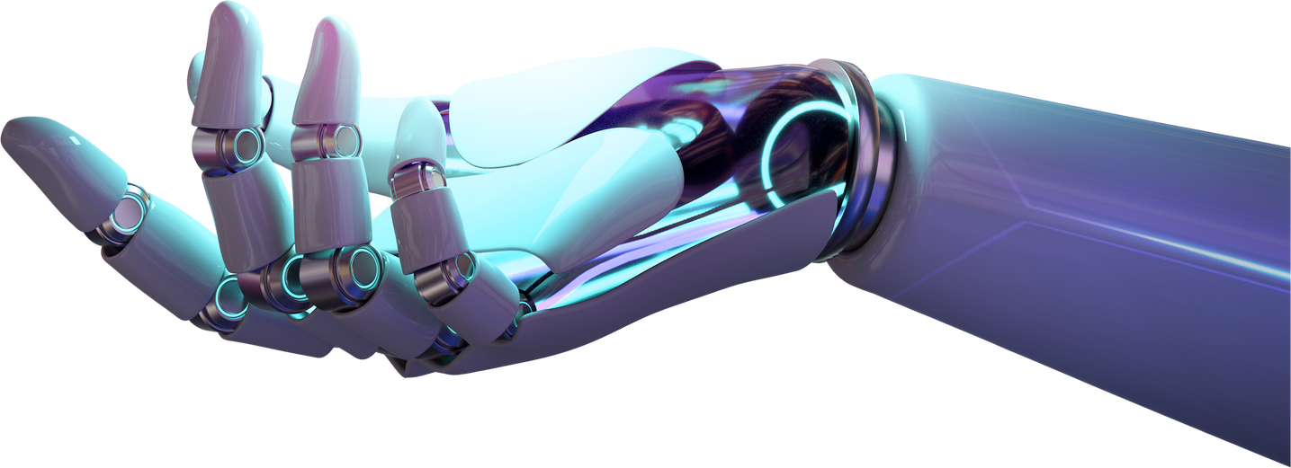
Carbon footprint
Generative AI and other AI technologies have a high carbon footprint. This is because they require a lot of computing power, which is often generated by fossil fuels. There are a number of things that can be done to reduce the carbon footprint of AI and ML, such as using more efficient hardware and cloud computing. AI can also be used to reduce carbon emissions in other sectors, such as buildings, transportation, manufacturing, and agriculture. As AI and ML technology continues to develop, we can expect to see even more innovative ways to reduce our carbon footprint.

Slide 18

Privacy concerns with ai
AI's reliance on personal data raises privacy concerns, including unauthorized access and biases.
AI can exacerbate or mitigate privacy risks, depending on its use.
Robust data protection, transparency, and awareness are key to safeguarding privacy in AI.

Slide 19

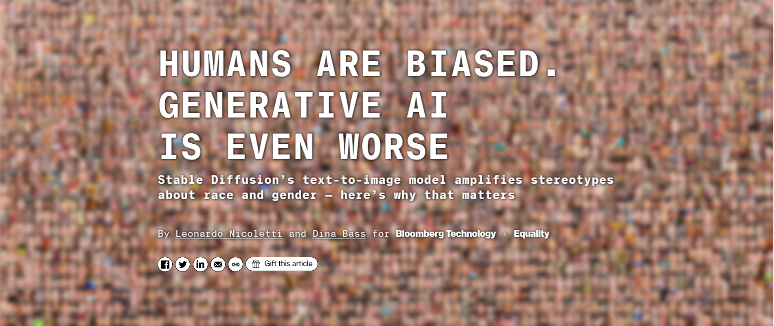
Let’s have a look at this article on Generative AI.

Slide 20
To conclude on this:
Generative AI systems can amplify existing biases, leading to harmful outcomes. Addressing these biases requires careful data selection, bias detection, and transparency. As generative AI evolves, proactive bias mitigation is crucial for responsible and ethical use.

Slide 21
Now let’s see authorities taking action for ai ethics!

Slide 22

AI ACT by European union
The European Commission has welcomed a political agreement reached between the European Parliament and the Council on the Artificial Intelligence Act (AI Act). The agreement is a historic milestone, marking the first-ever comprehensive legal framework on AI worldwide.
09 December 2023 | EU Website

Slide 23
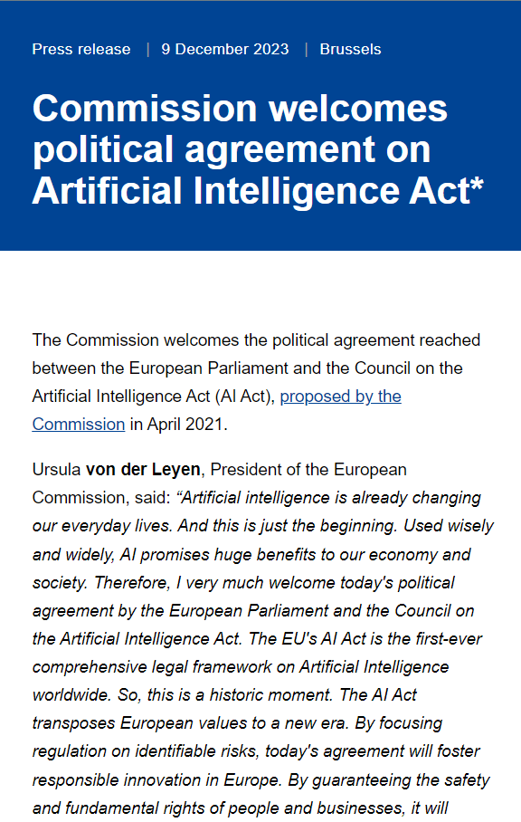
The AI Act follows a risk-based approach, with different rules for different types of AI systems.
Minimal risk: AI systems with minimal risk, such as AI-powered recommender systems or spam filters, will not be subject to any specific obligations.
High-risk: AI systems with high risk, such as those used in critical infrastructure or healthcare, will be subject to stricter requirements, including risk mitigation, data quality, logging, documentation, user information, and human oversight.
Unacceptable risk: AI systems that pose a clear threat to human rights, such as those that manipulate human behavior or use biometrics to identify individuals without their consent, will be banned.

Slide 24
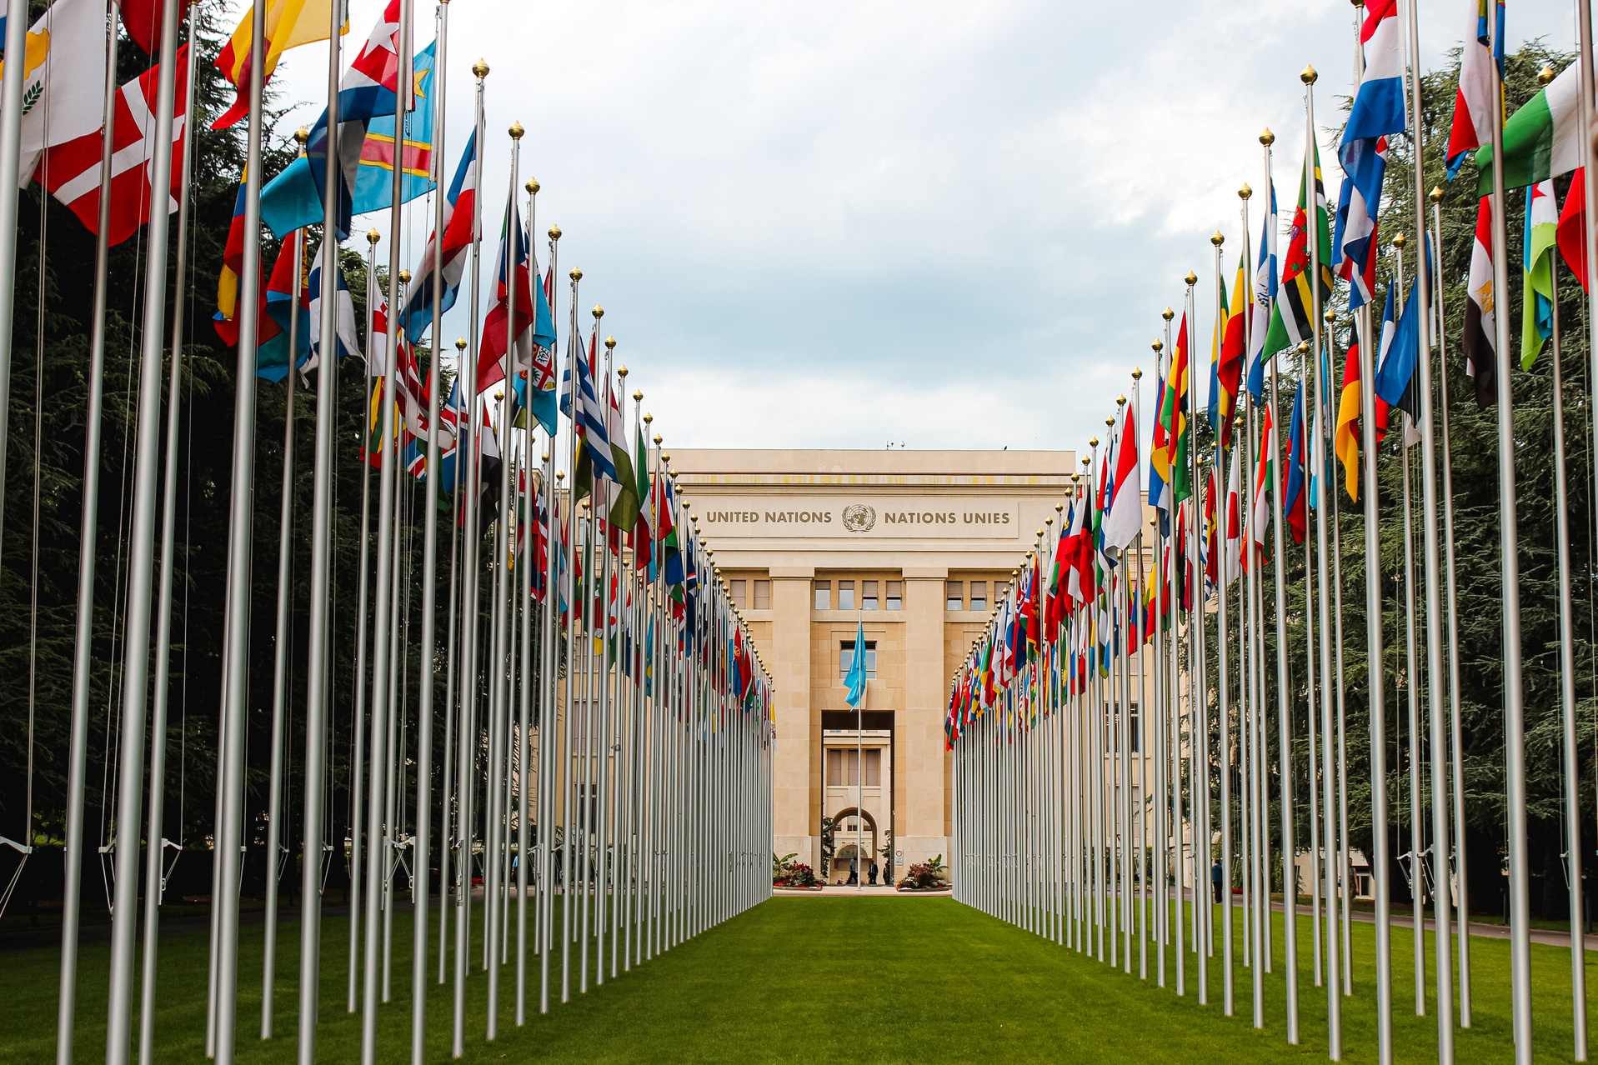
Action of united nations on ai
The High-level Advisory Body on Artificial Intelligence (HLPAB) is a group of experts convened by the United Nations Secretary-General to advise on the governance of artificial intelligence (AI). The HLPAB was established in 2021 and is composed of 38 members from government, the private sector, and civil society.

Slide 25
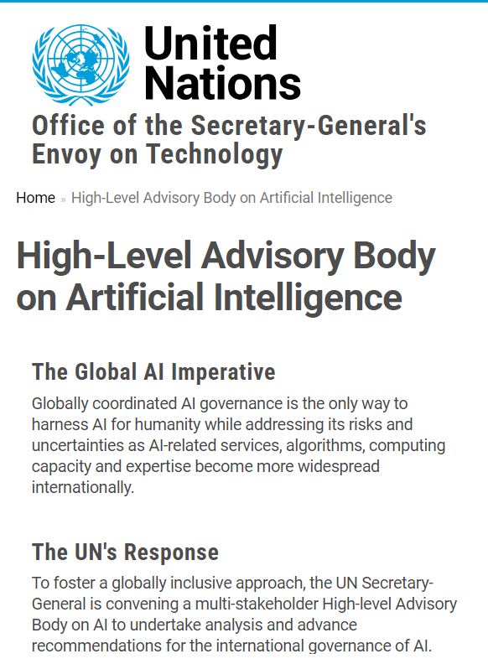
The High-level Advisory Body on Artificial Intelligence (HLPAB) is a group of experts convened by the United Nations Secretary-General to advise on the governance of artificial intelligence (AI). The HLPAB was established in 2021 and is composed of 38 members from government, the private sector, and civil society.
The HLPAB's mandate is to provide the Secretary-General with "independent and authoritative advice on the governance of AI, ensuring that AI is developed and used in a responsible and beneficial manner for all." The HLPAB will focus on four key areas:
Aligning AI governance with human rights and the Sustainable Development Goals
Promoting multi-stakeholder cooperation on AI governance
Enhancing trust and accountability in AI
Addressing the ethical and societal implications of AI

Slide 26
Is this really important to take such actions?
If your answer is No, have a look at the next slides.

Slide 27
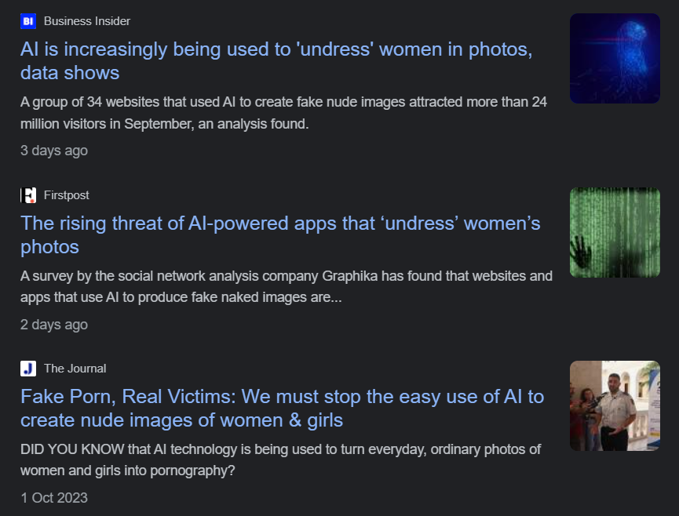
Misusing ai image generation
The news on unwanted and misusing of AI Image generation tools has become a question mark to the world. How to get away from this growing AI crisis?
Crawled on 11/12/2023

Slide 28
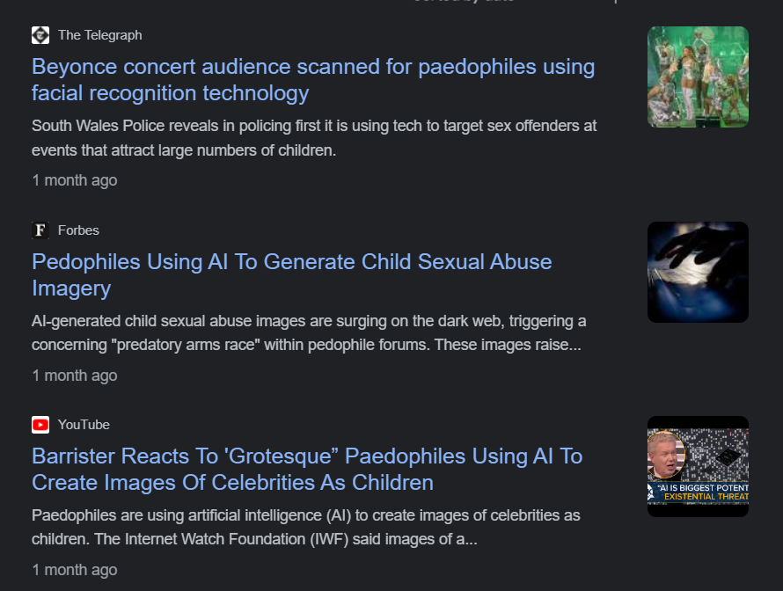
Paedophiles
using ai
The proliferation of AI-generated child sexual abuse material is a disturbing and rapidly growing problem. Law enforcement agencies and child protection organizations are struggling to keep up with the volume of this material, and there is a lack of legal clarity on how to prosecute its creation. Tech companies are also facing pressure to do more to prevent the spread of this material on their platforms.
Crawled on 11/12/2023

Slide 29
Conclusion
In closing, our examination of the ethical dimensions of AI highlights the imperative to balance innovation with ethical considerations.
As we harness AI's potential for positive societal impact, prioritizing fairness, transparency, and accountability is non-negotiable. Ethical AI practices build trust among users and the public, shaping a future where AI aligns with our shared values.
Navigating the ethical landscape of AI is a collective effort involving policymakers, industry leaders, researchers, and the public. Let's work together to ensure AI's responsible and ethical integration into our lives.

Slide 30
Q&a
Please feel free to express your thoughts, pose questions, or join in a discussion on the ethical aspects of AI.
Connect me on LinkedIn:
Rinshad Choorappara

